Slide 1



Programmable Packet Scheduling with a Single Queue
Zhuolong Yu
Chuheng Hu, Jingfeng Wu, Xiao Sun, Vladimir Braverman,
Mosharaf Chowdhury, Zhenhua Liu, Xin Jin

Slide 2
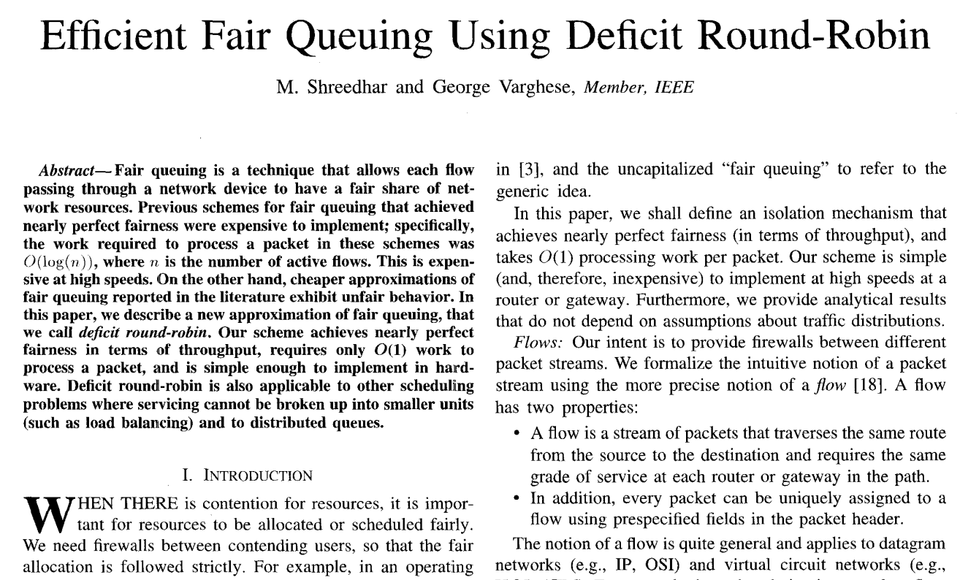
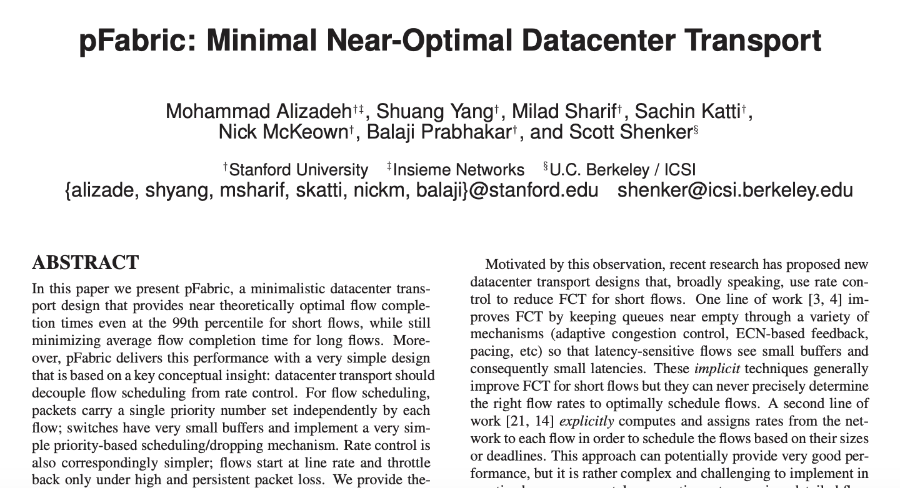
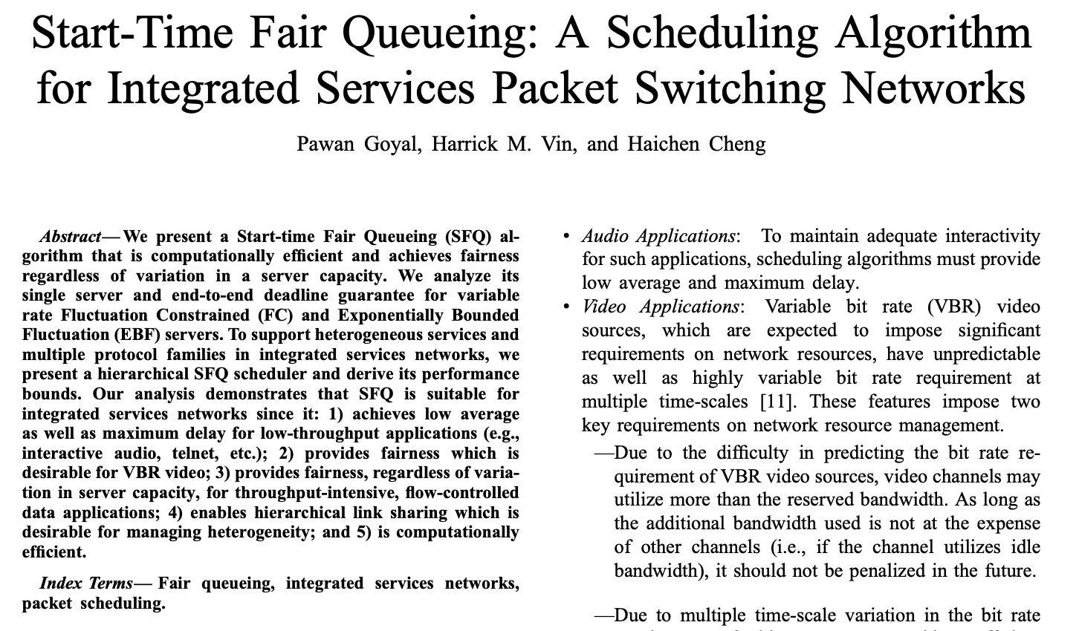
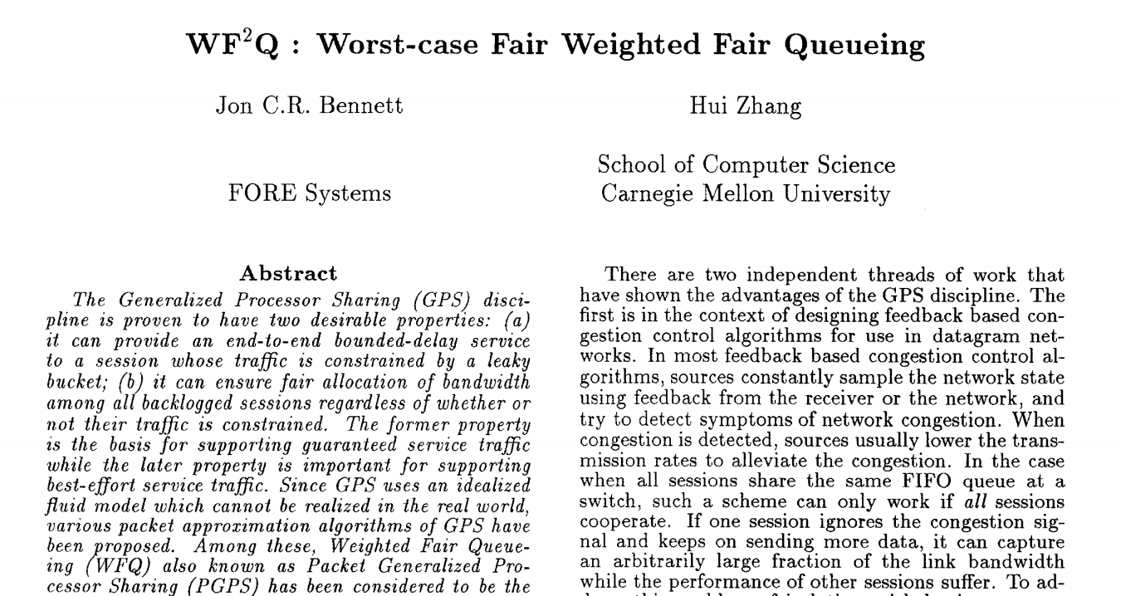
Packet Scheduling
Many packet scheduling algorithms have been designed for different properties
Lack of hardware support due to high cost to design and deploy switch ASICs

Slide 3
Programmable Packet Scheduling
Enables scheduling algorithms to be programmed into switch without changing the hardware design
FCFS
SRPT
STFQ
SRPT
……
……
Develop and deploy packet scheduling algorithms easily
Customize packet scheduling algorithms based on needs
Simplify the testing and deployment of new scheduling algorithms

Slide 4
Push-In First-Out (PIFO)
Rank computation
PIFO scheduler
pkt.rank
f = flow(pkt)
…
pkt.rank = get_rank(f, pkt)
9
6
3
2
Associate a rank with each packet and maintain a sorted queue to buffer packets
Newly arrived packets are inserted based on their ranks; packets are dequeued from the head
Different packet scheduling algorithms can be implemented on top of PIFO (e.g., SRPT, STFQ)

Slide 5
Push-In First-Out (PIFO)
STFQ rank computation
PIFO scheduler
f = flow(pkt)
pkt.start = max(f.finish, virt_time)
f.finish = pkt.start + pkt.len
pkt.rank = pkt.start
pkt.rank
9
6
3
2
Associate a rank with each packet and maintain a sorted queue to buffer packets
Newly arrived packets are inserted based on their ranks; packets are dequeued from the head
Different packet scheduling algorithms can be implemented on top of PIFO (e.g., SRPT, STFQ)

Slide 6
PIFO in practice
However, it is challenging to implement PIFO scheduler in practice, especially for switch ASICs
Deployability: require new ASIC implementation
Scalability: support a few thousands of flows

Slide 7
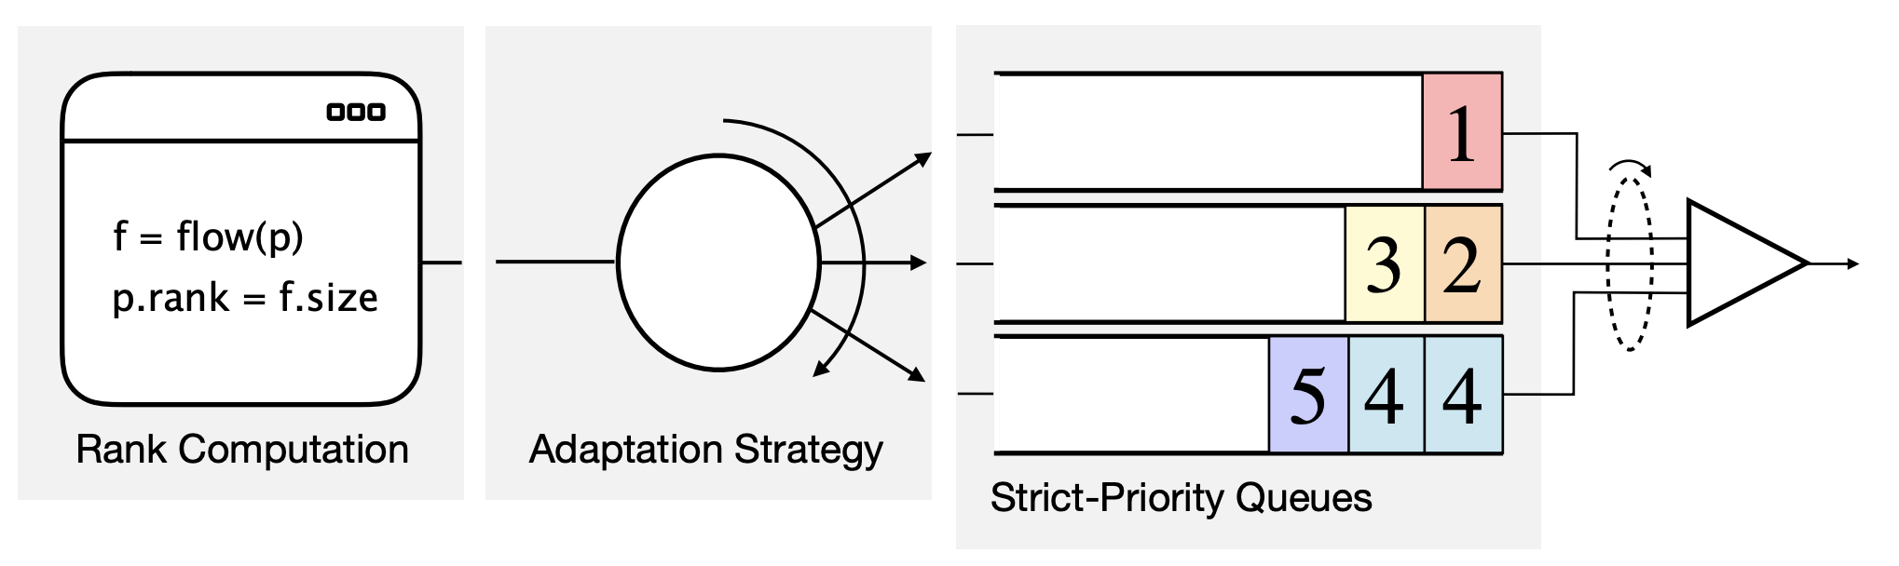
Approximation of PIFO: SP-PIFO (NSDI’20)
SP-PIFO is a deployable and scalable PIFO approximation
Map the ranks into a set of priorities and schedule the strict-priority queues
* This figure is from the SP-PIFO talk in NSDI 2020.
Require multiple strict-priority queues

Slide 8
Programmable Packet Scheduling
What is the minimal number of queues
to achieve programmable packet scheduling?
(on existing hardware)

Slide 9





Programmable Packet Scheduling
What does packet scheduling do?
Maintain the order
Drop the “right” set of packets
There are two trends in DCN: shallow buffer in the switches and fast-converging congestion control (e.g., HULL, Timely, Swift)

Slide 10
AIFO (Admission-In First-Out)
What is the “right” set of packets to drop?
Ideally we want to drop the same set of packets as PIFO

Slide 11

AIFO (Admission-In First-Out)
What is the “right” set of packets to drop?
Drop the packets with rank smaller than 3
Ideally we want to drop the same set of packets as PIFO
FIFO
2
1
2
5
4
1
2
5
4
1
FIFO
PIFO
2
1
2
5
4
1
2
2
1
1
PIFO
rank<3?
AIFO
2
1
2
5
4
1
2
1
2
1
FIFO

Slide 12
AIFO Design
Ideally we want to drop the same set of packets as PIFO
rank<3?
AIFO
2
1
2
5
4
1
2
1
2
1
FIFO
AIFO uses admission control to achieve the goal
Uses only one FIFO queue
Drops packets based on their ranks
Drops packets even when the queue has room (e.g., packet 4 and 5)

Slide 13
AIFO Design
Admission control
Need to handle dynamic traffic at line rate
rank<3?
9
7
9
9
8
9
2
1
2
5
4
1
2
1
2
1
……
1
5
1
5
5
9
9
8
9
9
FIFO
Match + Action
Memory
ALU
…
…
…
…
Programmable Parser
Programmable Match-Action Pipeline

Slide 14
AIFO Design
AIFO’s admission control consists of temporal component and “spatial” component
Temporal component
“Spatial” component
Packets are treated differently at a different “time”
Given the same “time”, different packets are treated differently
drop
admit
3
3
2
1
3
1
drop
admit
3
3
2
1
1
3
2
1

Slide 15
AIFO Design
AIFO’s admission control consists of temporal component and “spatial” component
Temporal component
“Spatial” component
Discrepancy between arrival rate and departure rate
Relative rank of the arriving packet
queue.len() growing means arrival rate > departure rate
queue.len() decaying means arrival rate < departure rate
Use a sliding window (W) to track the ranks
Use quantile* to express the relative rank
*W.quantile(p): given a packet p, return the number/percentile of packets with smaller rank than p in W.
[1,2,4,5].quantile(3)=50%

Slide 16

AIFO Design
AIFO’s admission control consists of temporal component and “spatial” component
Temporal component
“Spatial” component
Quantile of the packet rank in the sliding window: W.quantile(pkt)
Queue length: c
Queue size: C
Admission control condition:
$$W.quantile\left(pkt\right)>\frac{C−c}{(1−k)C} ?drop:admit$$

Slide 17

AIFO Design
Admission control condition:
$$W.quantile\left(pkt\right)>\frac{C−c}{(1−k)C} ?drop:admit$$
large
Threshold:
0
.1
.2
.3
.4
.5
.6
.7
.8
.9
1
drop
quantile
Queue length:
10
9
8
7
6
5
4
3
2
1
0
admit
small
queue length
large
headroom k*C
allowing all the packets

Slide 18
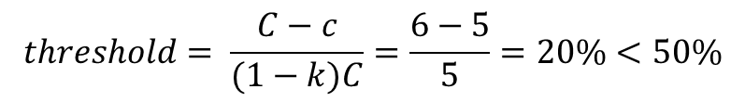
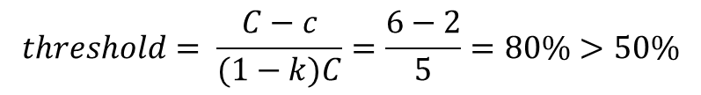
AIFO Design
Example: when a packet with quantile=50% comes
$$threshold= \frac{C−c}{(1−k)C}=\frac{6−2}{5}=80\%>50\%$$
$$threshold= \frac{C−c}{(1−k)C}=\frac{6−5}{5}=20\%<50\%$$
admit
drop
pkt.quantile = 50%
k=1/6, C=6, c=2
pkt.quantile = 50%
k=1/6, C=6, c=5
(a) When the queue length is 2
(b) When the queue length is 5

Slide 19
AIFO Design
How to compute W.quantile(pkt) ?
i: 0
i: 4
i: 8
i: 12
i: 1
i: 5
i: 9
i: 13
window slides
i: 2
i: 6
i: 10
i: 14
head
i: 3
i: 7
i: 11
i: 15
head
stage 1
stage 2
stage 3
stage 4
window on data plane

Slide 20
AIFO Design
How to compute W.quantile(pkt) ?
Head
i: 0
r: 2
i: 4
r: 9
i: 8
r: 1
i: 12
r: 7
pkt.index: 4
pkt.rank: 5
i: 1
r: 7
i: 5
r: 2
i: 9
r: 3
i: 13
r: 28
Index
Tagger
Admission
Control
i: 2
r: 8
i: 6
r: 15
i: 10
r: 2
i: 14
r: 4
Sampler
i: 3
r: 9
i: 7
r: 6
i: 11
r: 8
i: 15
r: 25
Feed 1 packet into the window
for every n packets
stage 1
stage 2
stage 3
stage 4

Slide 21
AIFO Design
Update the r value at cell [pkt.index]
Compare pkt.rank with the ranks (r) in each cell
Get quantile: W.quantile(pkt)=6/16=37.5%
How to compute W.quantile(pkt) ?
update r = 5
i: 0
r: 2
i: 4
r: 9
i: 8
r: 1
i: 12
r: 7
Get quantile for the packet
Update the sliding window
i: 4
r: 9
pkt.index: 4
pkt.rank: 5
i: 1
r: 7
i: 5
r: 2
i: 9
r: 3
i: 13
r: 28
Index
Tagger
Admission
Control
i: 2
r: 8
i: 6
r: 15
i: 10
r: 2
i: 14
r: 4
Sampler
i: 3
r: 9
i: 7
r: 6
i: 11
r: 8
i: 15
r: 25
Smaller than pkt.rank
Larger than pkt.rank
stage 1
stage 2
stage 3
stage 4

Slide 22
Evaluation
Testbed experiments
6.5 Tbps Barefoot Tofino switch
5 servers with an 8-core CPU and a 40G NIC
Comparison: FIFO, SP-PIFO
Workload: UDP, TCP
Large-scale simulations
Simulator: Netbench
Topology: 9 Leaf – 4 Spine – 144 Servers topology
Comparison: PIFO, PIEO, SP-PIFO, TCP, DCTCP, AFQ
Workload: Web search workload
Applications: SRPT, STFQ
Switch
40G
S₁
S₂
S₃
S₄
S₅

Slide 23
Evaluation
How does AIFO work in a datacenter setup?
SRPT
STFQ
How does the parameters affect AIFO?
Parameter K
Queue length
Window length and sampling rate
Is the admitted packet set similar with PIFO?
How does AIFO work on hardware testbed?
What is AIFO’s resource consumption?

Slide 24
Evaluation
How does AIFO work in a datacenter setup?
SRPT
STFQ
How does the parameters affect AIFO?
Parameter K
Queue length
Window length and sampling rate
Is the admitted packet set similar with PIFO?
How does AIFO work on hardware testbed?
What is AIFO’s resource consumption?

Slide 25
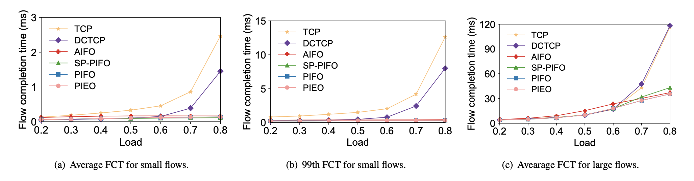
Evaluation
How does AIFO work in a datacenter setup
Close to the state-of-the-art solutions

Slide 26
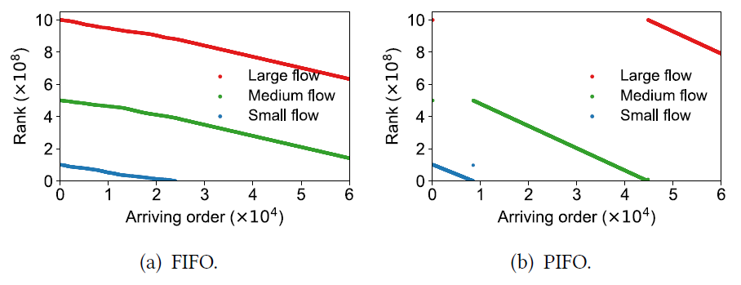
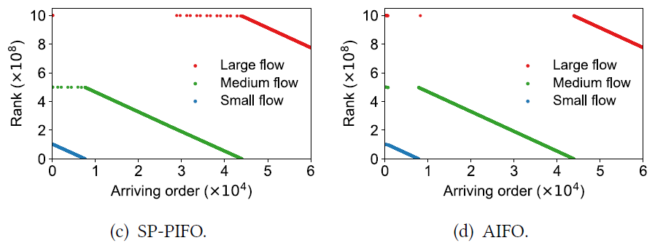
Evaluation
The admitted set is similar as PIFO
S₁
S₂
R₁
S₃
Three senders, each sends one flow to a receiver at the same time
The size of the three flows are 100MB (large), 50MB (medium) and 10MB (small), respectively
Running SRPT
The results logged at receiver side
AIFO approximates PIFO closely

Slide 27
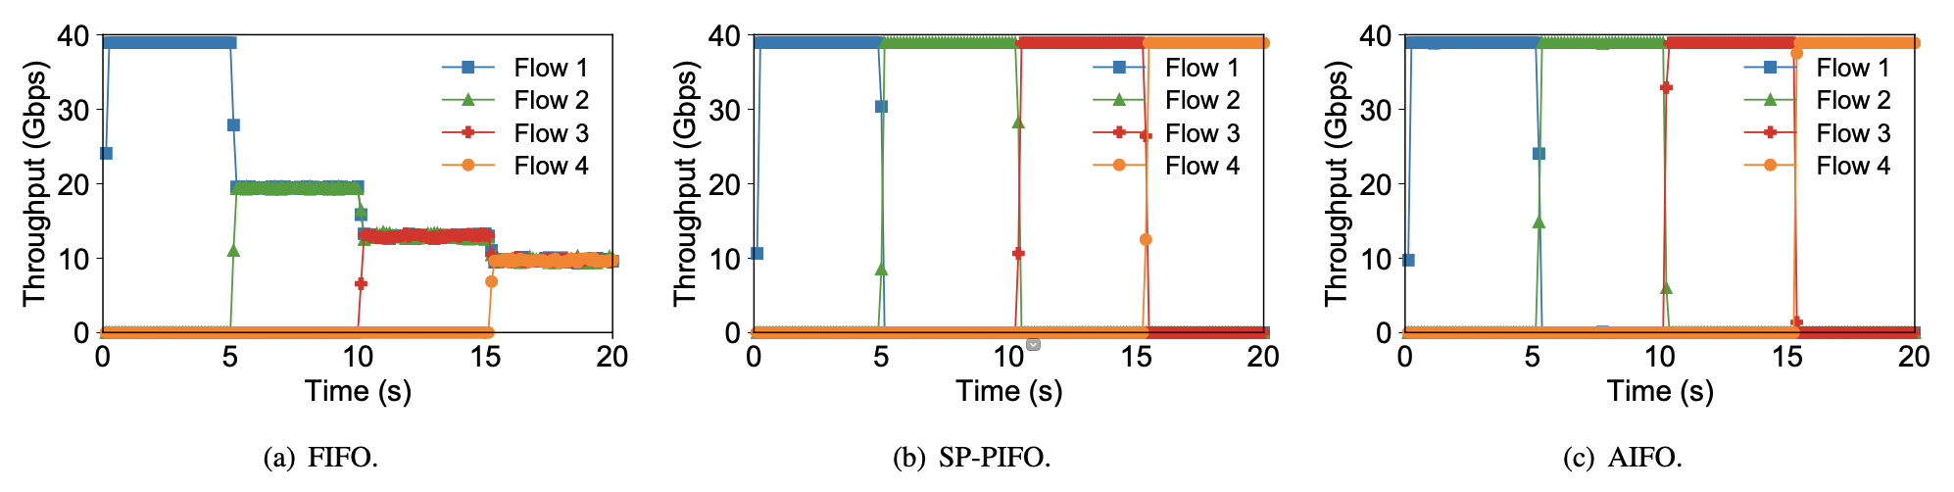
Evaluation
How does AIFO work on hardware testbed
4 senders send UDP traffic to 1 receiver, priority: f4>f3>f2>f1
High priority flow dominates the bandwidth

Slide 28
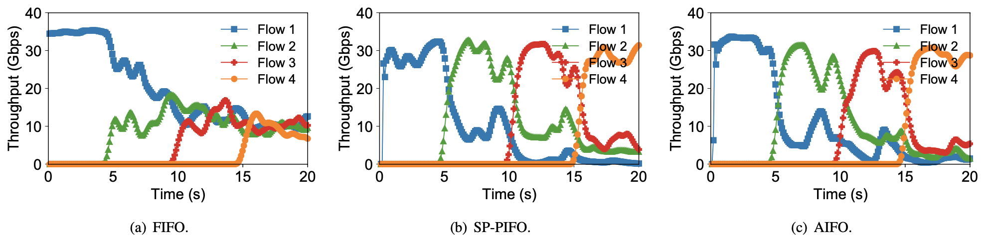
Evaluation
How does AIFO work on hardware testbed
4 senders send TCP traffic to 1 receiver, priority rank: 4>3>2>1
High priority flow dominates the bandwidth

Slide 29


Conclusion
AIFO is a programmable packet scheduling approach using only one queue
github.com/netx-repo/AIFO
zhuolong@cs.jhu.edu

Slide 30
Thank you!
github.com/netx-repo/AIFO
zhuolong@cs.jhu.edu

